Slide 1
Assembly Language
Lab 5
2022/10/17

Slide 2
Objectives
Compare the numbers of myID and myID2. If they are equal, the result will become A. If the number of myID > the number of myID2, the result will become B. If the number of myID < the number of myID2, the result will become C.
example:
myID = 103522087 myID2 = 103522112
result = " AAAAAACBB“
.data
myID byte "_______" ; Team leader student ID
myID2 byte "_______" ; Team member student ID
size_ID = _______ ; size_ID indicates the length of myID
result byte 9 DUP(?) ; save the result
.code
main PROC
[do something...]
exit
main ENDP
END main

Slide 3
Hint
When executing the code, if the jump instruction is not executed, the program will continue to execute downward.
When jump and loop are used together, you must use the jump command carefully. If you execute the jump command in the wrong place and pay attention to the exit position, it may lead to the execution of the wrong line command.

Slide 4
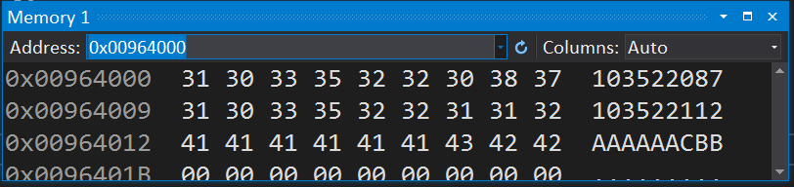
Program Result

Slide 5
Report
Due Date (2022/10/18)
Before 12:00
If you submit late, please send a letter to the teaching assistant, points will be deducted
Group Task
Compress(.zip,.rar) the following file with the name of the group ( e.g. lab5_01.zip)
Code(lab5_01.asm)
Report(lab5_01.doc or lab5_01.pdf)
Report Title
Group, name, student ID
Step by step of program execution flow, memory (register) status
Screenshots description, code Description
Reviews for the class, lesson learned, the tools we used, TA, etc

Slide 6
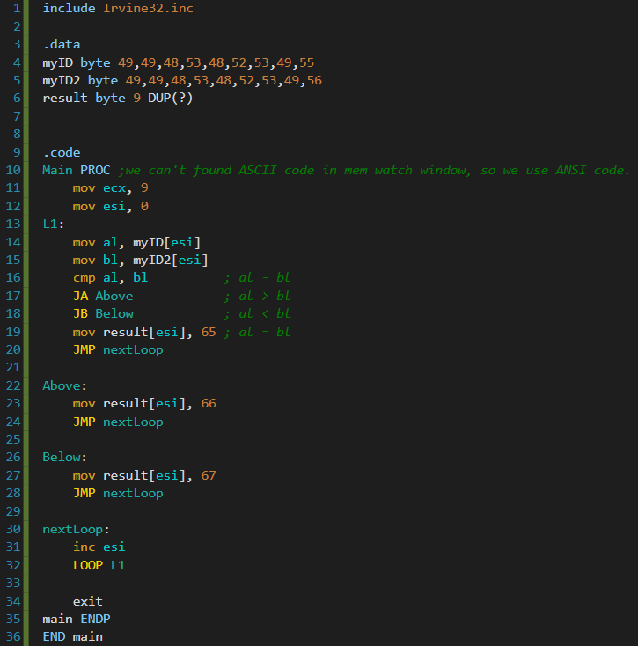
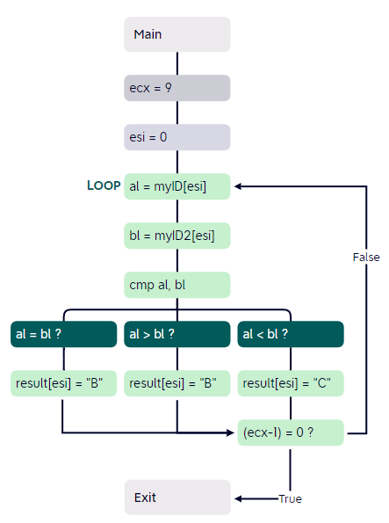











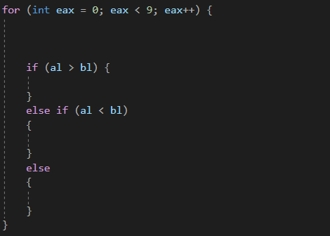

Default
Flag Change
When al == bl
When al < bl
When inc esi
+5 loop…

